Slide 1


Risk Reduction Through Preventative Maintenance
Marcus Neal
MN AgSolutions LLC
marcus@mnagsolutions.com
Notes:
Global application regardless of industry. Risk and Maintenance impacts everyone at some level.

Slide 2
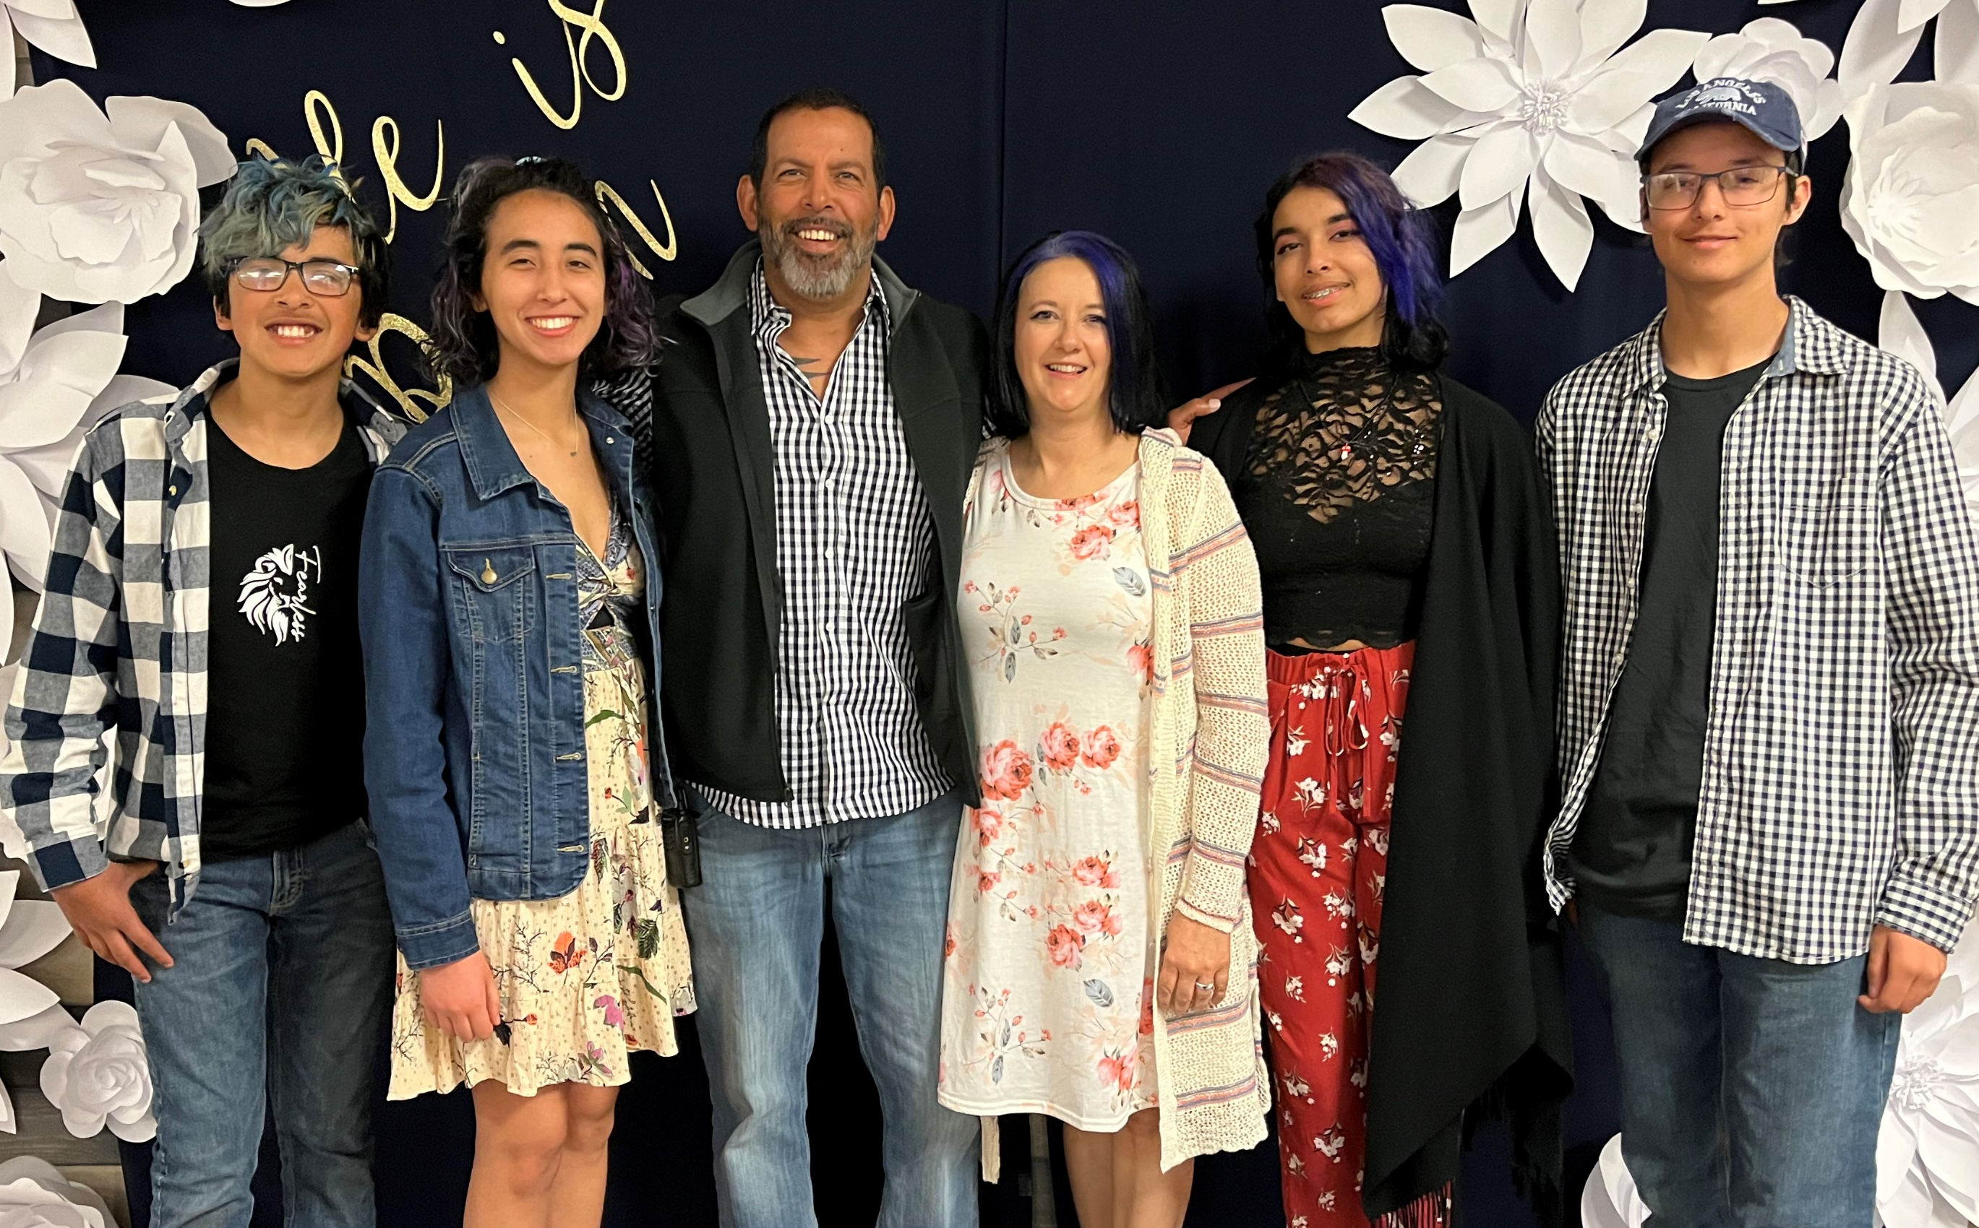
Who is Marcus Neal?
Follower of Christ, Husband, and Father
U of MN Ag Engineer
25+ years designing, building, assessing, and acquiring ag-based storage & processing
Asia, Mexico, Canada, East, West, Midwest
2016-17 GEAPS Intl President + 2yrs Intl Chair
Kansas State IGP Advisory Board
3rd Degree BB in TaeKwonDo
U of MN Cheerleader
Prince (The Artist Formally Know As)
“Commit to the Lord whatever you do, and He will establish your plans” – Proverbs 16:3
Notes:
If you take nothing else away about who I am…it is this 1st line. Everything else is built from this foundation.

Slide 3
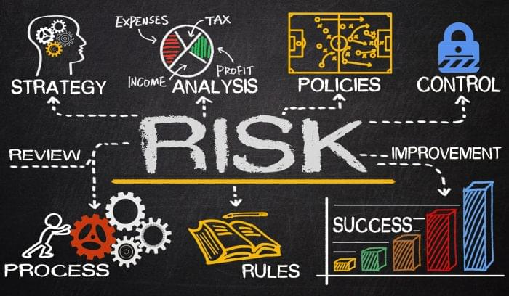
Risk Management vs Risk Mitigation vs Risk Reduction
Risk Management – The system used to include the process to identify, evaluate, and prioritize risk AND how to deal with it.
Risk Mitigation – Proceed and how to make the activity less risky.
Risk Reduction – Includes avoiding the activity altogether – risk avoidance.
Notes:
Be clear about what we are discussing.

Slide 4

What is Preventative Maintenance?
Regular, scheduled activities to HELP prevent unexpected future failures.
4 Types of PM
  Usage Based (Use)
  Calendar Based (Time)
  Predictive Maint. (Metrics)
  Prescriptive Maint. (Why)
Notes:
Car oil example to include everyone.

Slide 5
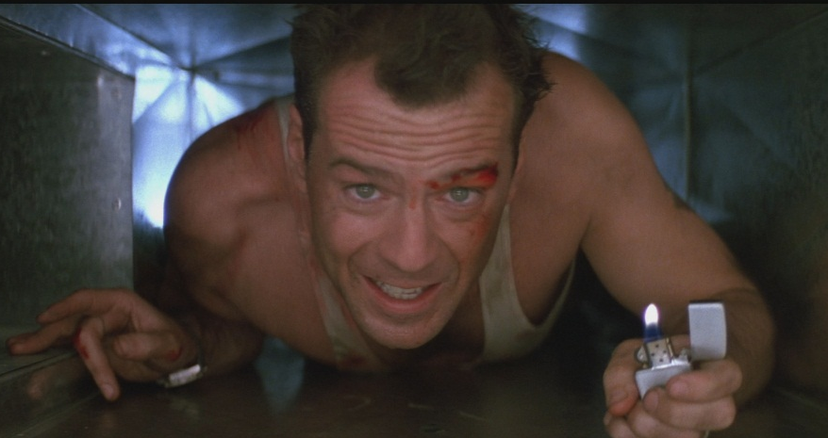
Why is Preventative Maintenance Important in any Operation?
A flaw in the human character is that everybody wants to build and nobody wants to do maintenance. – Kurt Vonnegut
“If you’re not part of the solution, you’re part of the problem. Stop being part of the problem.” –John McClane - Die Hard
Notes:
2 quotes drive home this point for me. And I have used throughout my career in leadership and management.

Slide 6
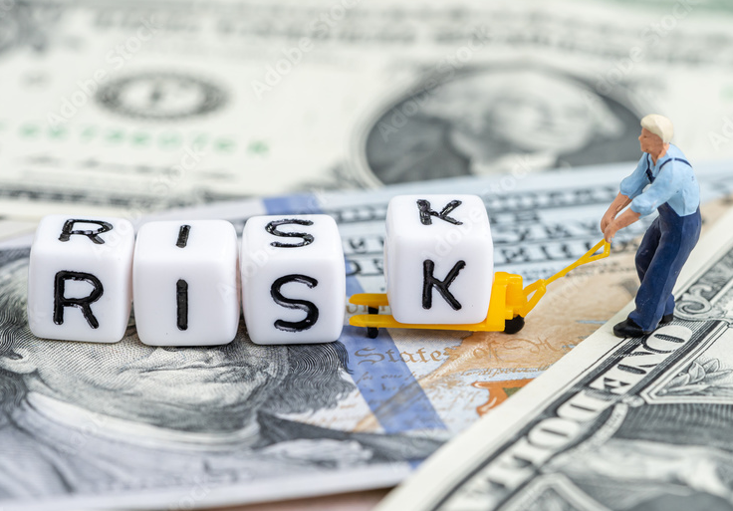
Practical and Real-World Solutions
Goal: Reduce the likelihood of failure
Goal: Reduce the consequences of a failure
Redundancy (Critical processes)
PM and PDM (Routine)
Spare Parts (Lead time)
Special Training (Operate, Repair, or Maintain)
Asset Replacement (Desired Level of Service)
Monitoring (See, Touch, Smell)
Notes:
2 Goals are really at the heart and why displayed together. 6 specific areas that I believe cover every situation I have faced.

Slide 7
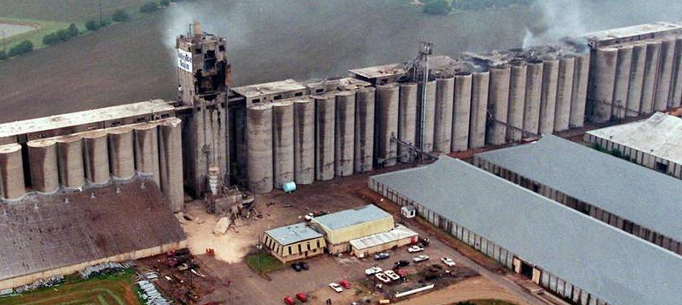
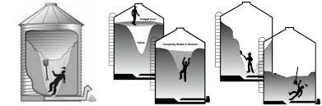
Agri-Business (Food and Feed) Industry
Catastrophic Consequences
  Grain (Organic) Dust Explosions
  Storage Bin Engulfment
Identify & Use Resources Available
  OSHA, FDA, USDA, Associations
  Insurance Company
  OEM and Suppliers
  Internal Knowledge
  Consultants (Experienced)
Notes:
Zero tolerance for Hot Work (cutting and welding). Special permission, drilling, and brass only (expensive, but creates very limited risk).
Zero tolerance for Permit Required Confined Space Entry. Zero tolerance for bin entry

Slide 8
Additional Preventative Maintenance Strategies
Run To Failure…Seriously?
Develop a Risk Profile specifically for PM
Experience can be the best teacher!
Communication…and more Communication
Notes:
Disposable furniture vs family heirlooms.

Slide 9
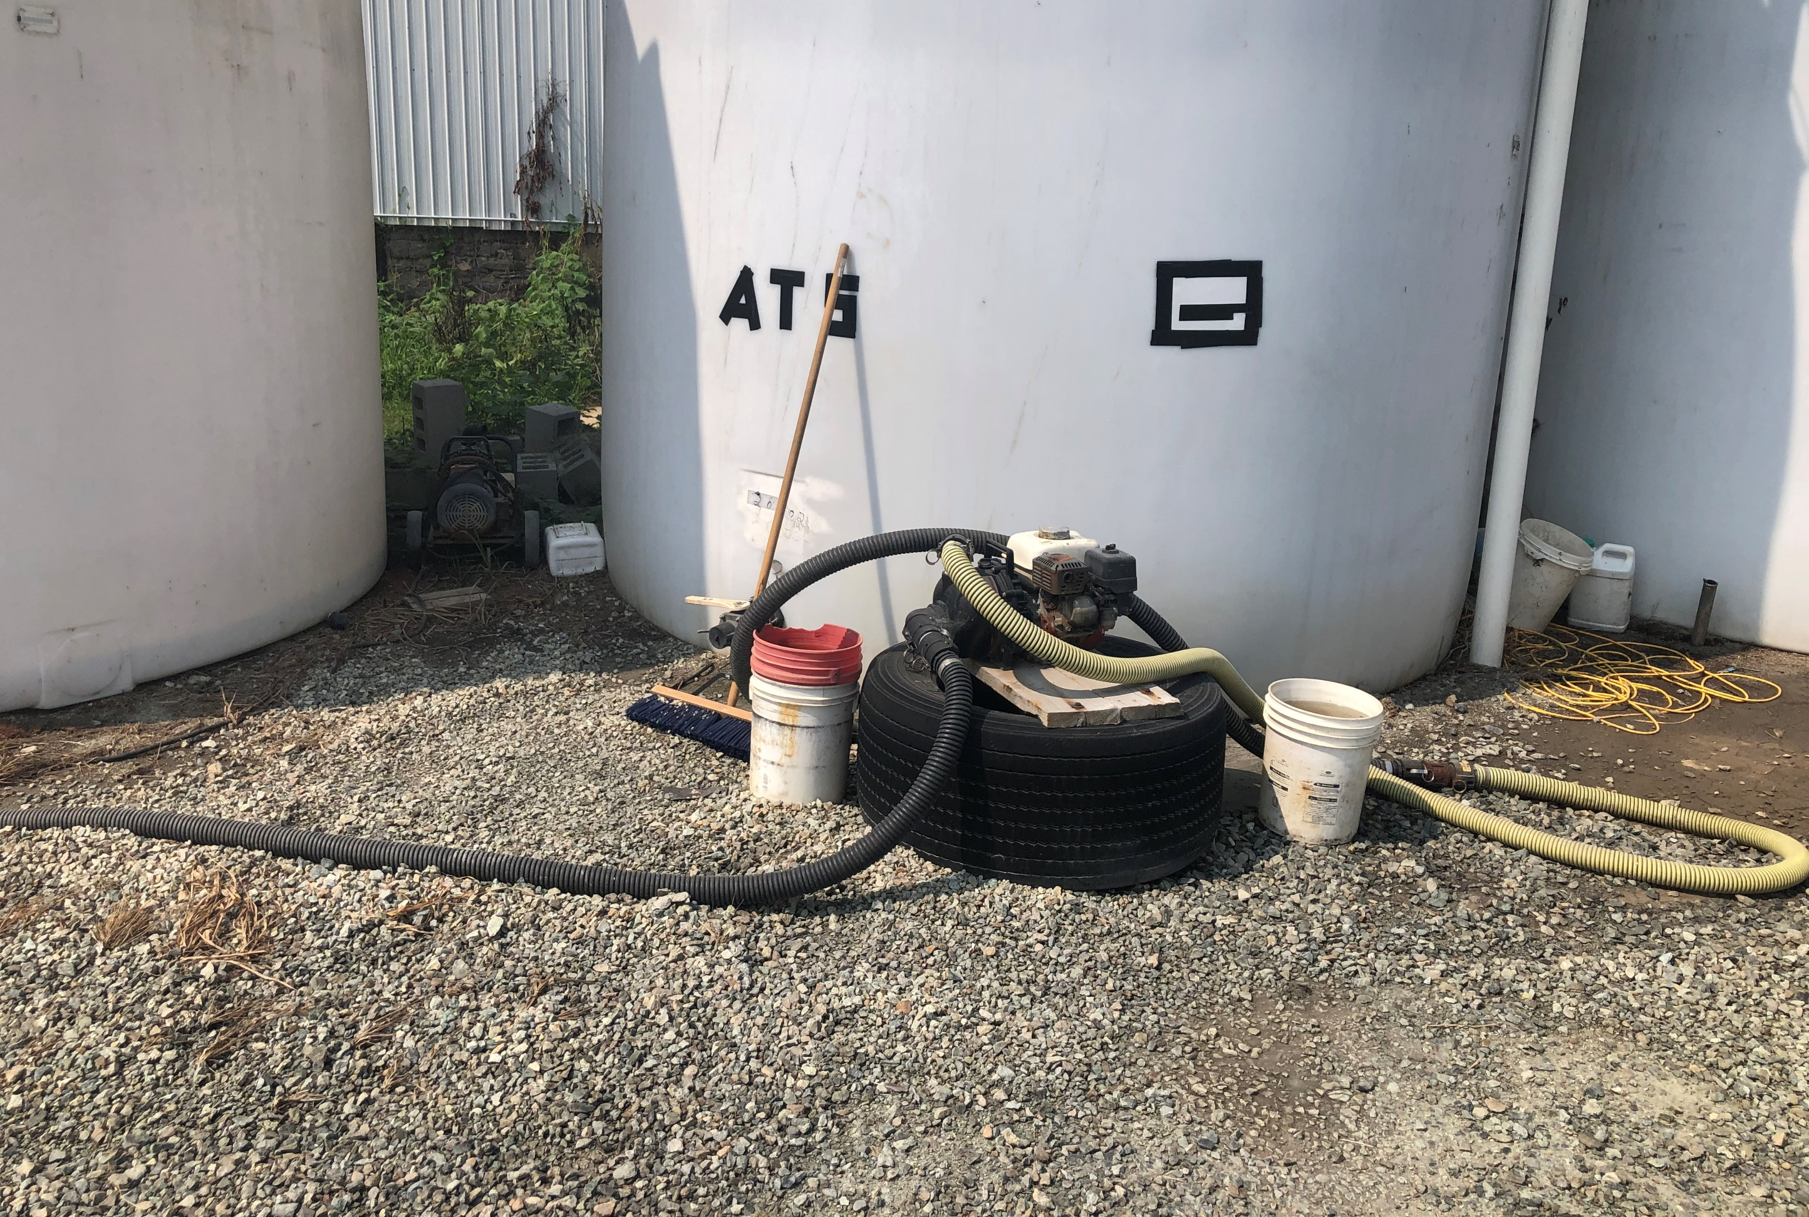
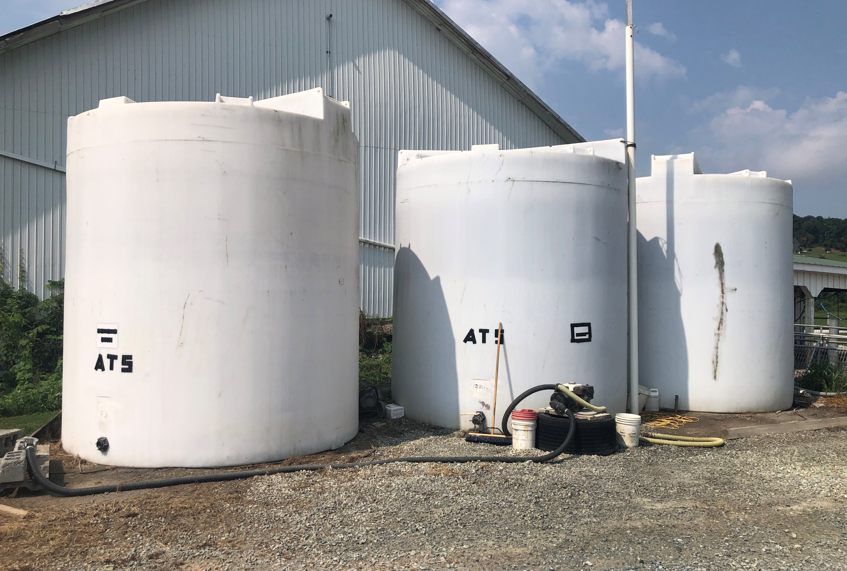
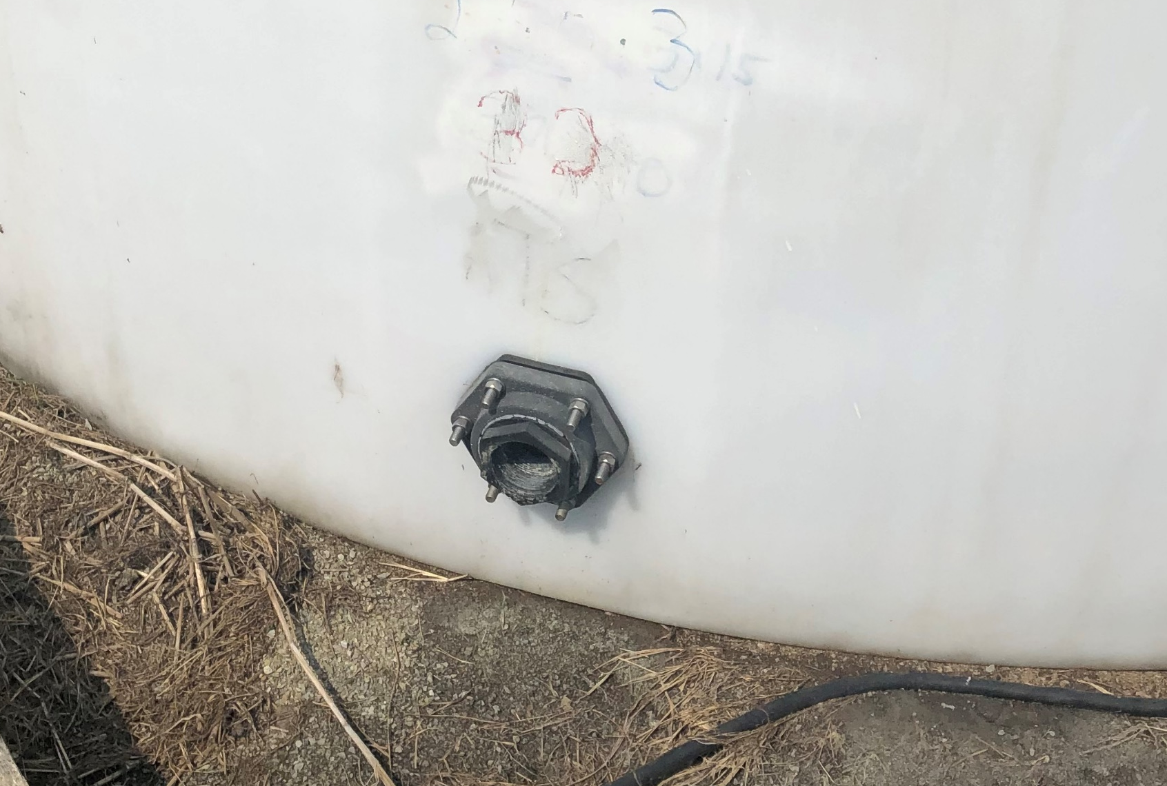
Notes:
Liquid fertilizer tanks example

Slide 10
Additional Preventative Maintenance Strategies
Run To Failure…Seriously?
Develop a Risk Profile specifically for PM
Experience can be the best teacher!
Communication…and more Communication
Build Relationships – between people and assets
Risk Reduction Through Preventative Maintenance is about PEOPLE!
Notes:
Disposable furniture vs family heirlooms.

Slide 11
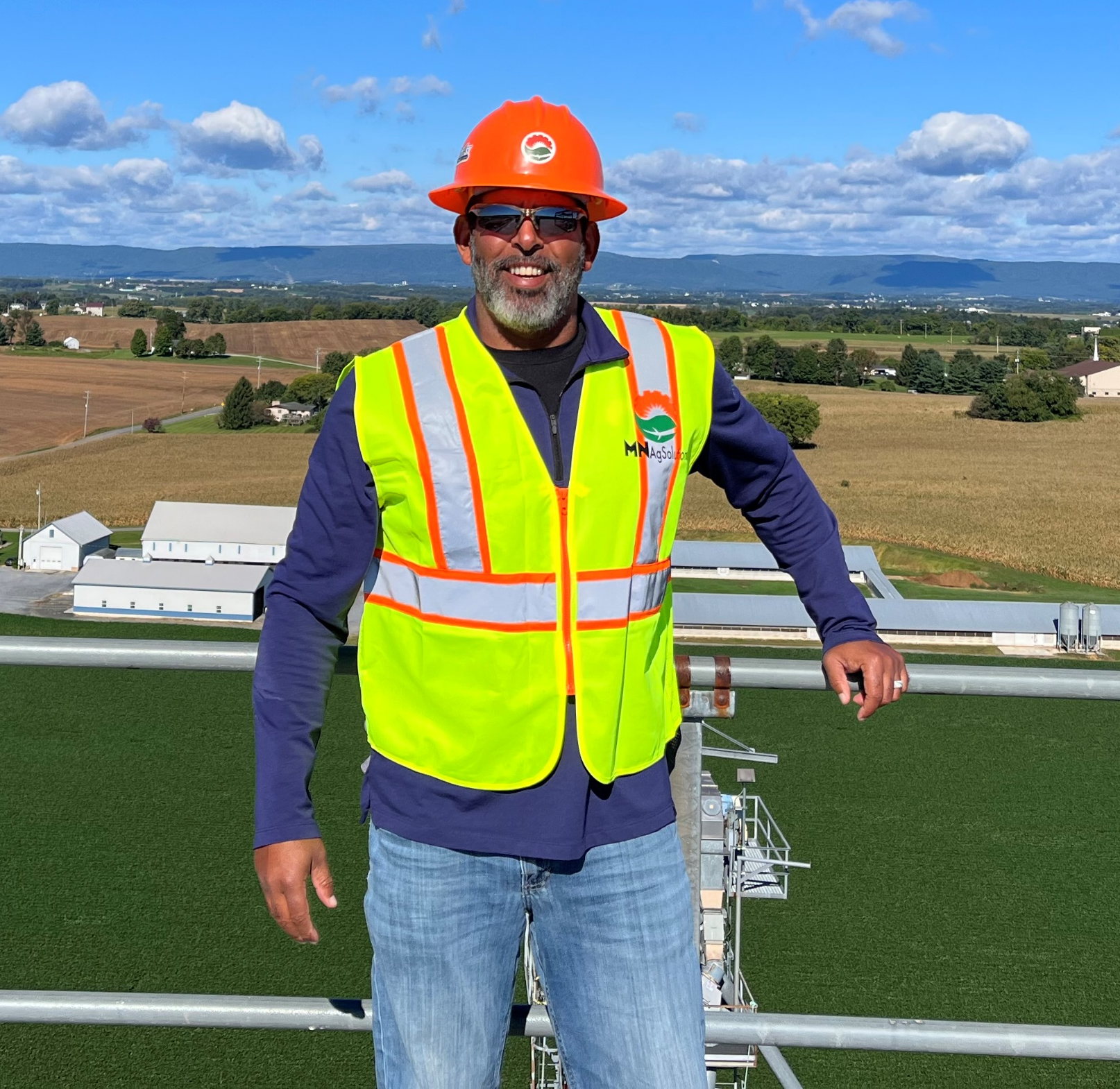
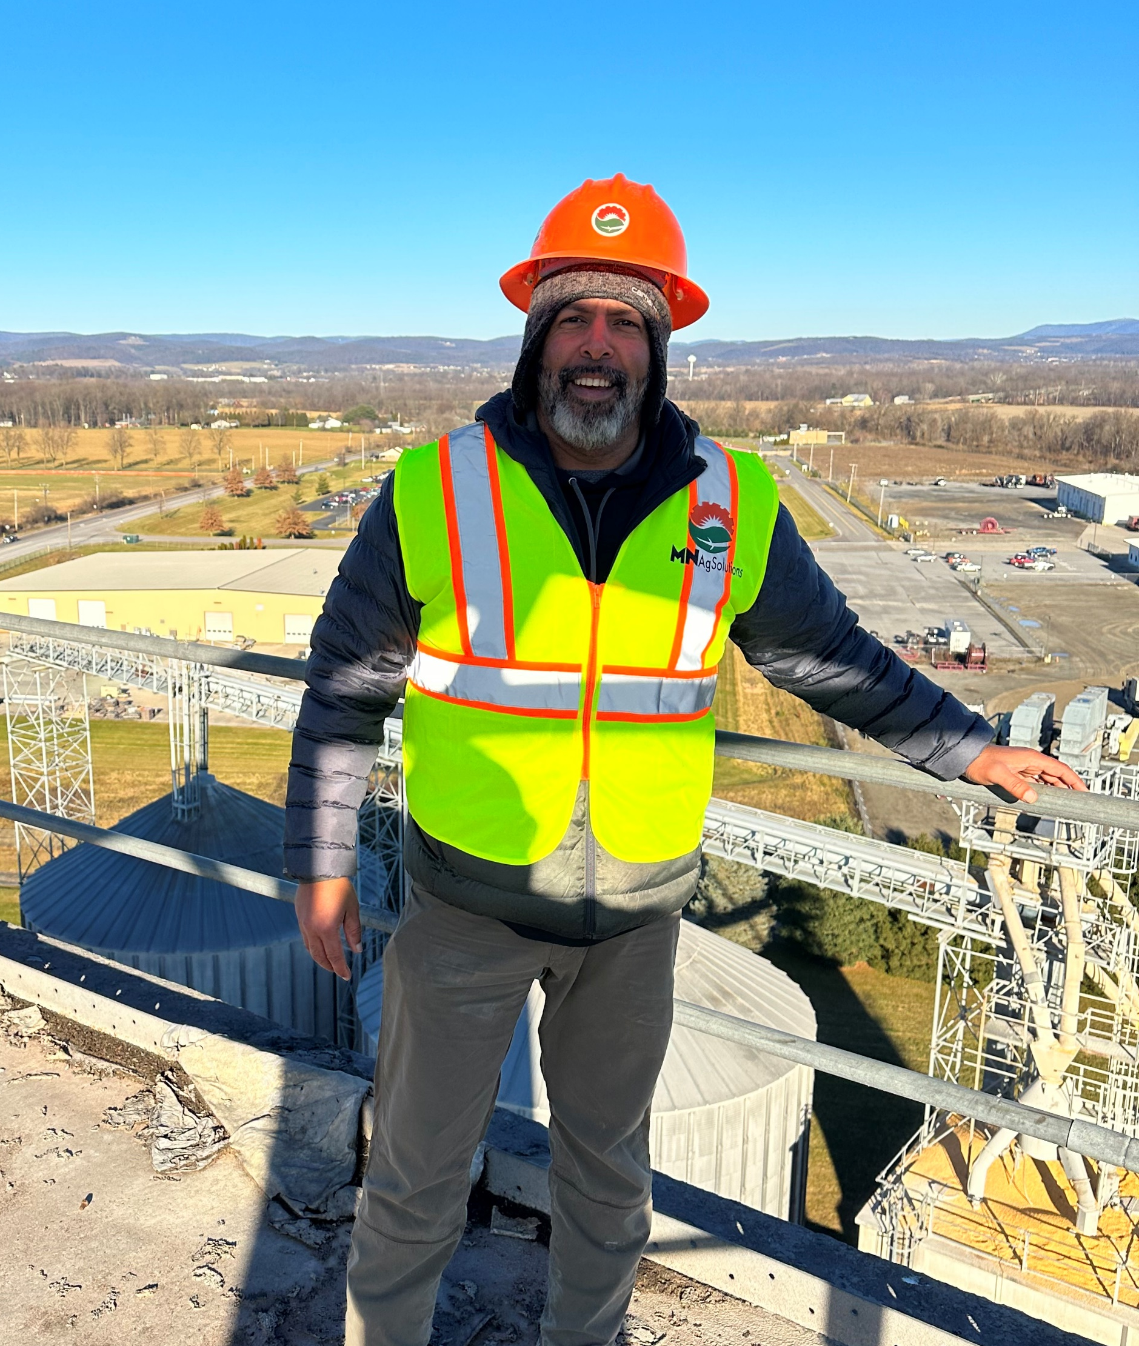
Q & A
Thank You!
Marcus Neal – MN AgSolutions LLC
marcus@mnagsolutions.com – 913.991.2284

